Slide 1
Sinner and saint: The Church & Racism
Pastor Pam fickenscher and Pastor Jonathan Davis

Slide 2
Introductory Issues
As white clergy, and as a white male, it is important to decentralize our voices.
Exodus 2:23-24 - The Israelites groaned under their slavery, and cried out. Out of the slavery their cry for help rose up to God. God heard their groaning.
As white clergy, and as a white male, it is important to speak up and not delegate our own work.
“In the end we will remember not the words of our enemies, but the silence of our friends.” – MLK JR

Slide 3
Core Lutheran Belief – Sinner and Saint
100% Sinner
Capable of hurt and destruction
In need of God’s grace
100% Saint
Made in the image of God
Forgiven
Capable of and called to love in this world

Slide 4
Dr. James Cone (1938-2018)
Professor of Systematic Theology
Union Theological Seminary

Slide 5
The Cross
What does it mean to you?

Slide 6
The Cross
What does it mean to you?

Slide 7
The Cross
What does it mean to you?

Slide 8
Dr. James Cone
In the 1st Century, crucifixion was the form of execution by the Roman Empire for insurrectionists and rebels… “It was a public spectacle accompanied by torture and shame – one of the most humiliating and painful deaths ever devised by human beings.”
The Tortured Christ, Guido Rocha, 1975, Brazil

Slide 9
“They put him to death by hanging him on a tree.”
Acts 10:39

Slide 10
Dr. James Cone, The Cross and the Lynching Tree, pg. 31
“The crucifixion of Jesus by the Romans in Jerusalem and the lynching of blacks by whites in the US are so amazingly similar that one wonders what blocks American Christian imagination from seeing the connection.”

Slide 11
IDA B. Wells
Journalist, Educator, early Civil Rights activist

Slide 12
Ida B Wells, as quoted in The Cross and the Lynching Tree, pg. 131
“During all the years…in which men and women and children were being scourged, hanged, shot, and burned…the Women’s Christian Temperance Union had no word, either pity or protest; its great heart, which concerns itself about humanity the world over, was toward our cause, pulseless as a stone.”

Slide 13
The cross: Horror and Hope
“It made no rational or even spiritual sense to say that hope came out of a place called Golgotha…” In St. Paul’s words, it is foolishness,” because it inverts the world’s value system with the news that hope comes by way of defeat, that suffering and death do not have the last word, that the last shall be first and the first shall be last….That God could ‘make a way out of no way’ in Jesus’ cross was truly absurd to the intellect, yet profoundly real in the souls of black folk. Enslaved blacks who first heard the gospel message seized on the power of the cross…The cross was God’s critique of power – white power – with powerless love, snatching victory out of defeat.” - James Cones, pg. 2

Slide 14
The Sin of White American Churches
The silence and the inability (or unwillingness)
to make the connection of the cross and the lynching tree.

Slide 15
W .Fitzhugh Brundage , as quoted in The Cross and the Lynching Tree
“Perhaps nothing about the history of mob violence in the United States is more surprising than how quickly an understanding of the full horror of lynching has receded from the nation’s collective historical memory.”

Slide 16
Rev. Dr. Martin Luther King Jr. The Letter from Birmingham Jail
“I must honestly reiterate that I have been disappointed with the church…I say this as a minister of the gospel, who loves the church…I felt we would be supported by the white church. I felt that the white ministers, priests and rabbis of the South would be among our strongest allies. Instead, some have been outright opponents, refusing to understand the freedom movement and misrepresenting its leaders; all too many others have been more cautious than courageous and have remained silent behind the anesthetizing security of stained glass windows.”

Slide 17
Dr. James Cone The Cross and the Lynching Tree, pg. 166
“If America (and the white church) has the courage to confront the great sin and ongoing legacy of white supremacy with repentance and reparation there is hope ‘beyond tragedy’.”

Slide 18
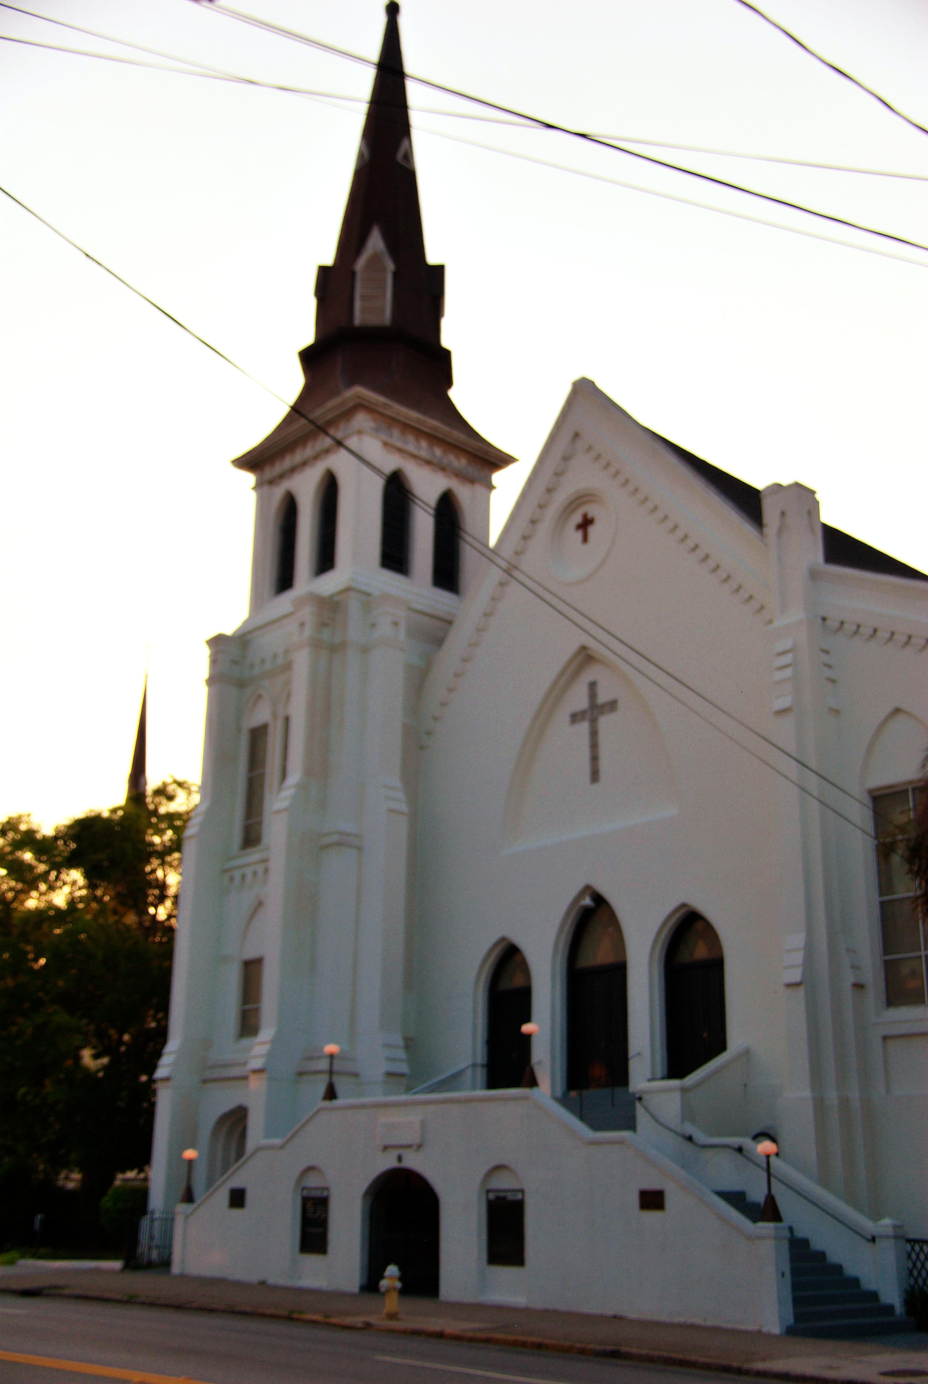

Slide 19
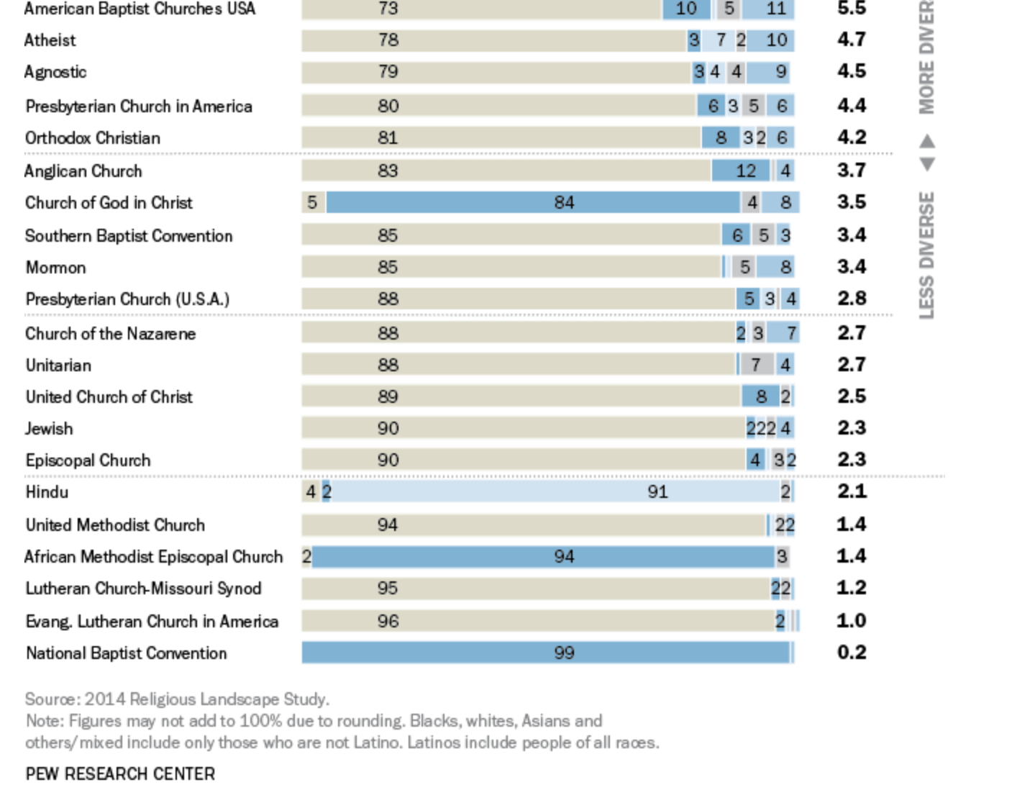

Slide 20
ELCA Strategy for authentic Diversity
The Evangelical Lutheran Church in America is a predominantly white, middle-class church, most of whose members are of European descent. Intentional outreach efforts have increased the proportion of nonwhite members (African descent, American Indian and Alaska native, Asian and Pacific islander, Arab and middle Eastern, and Latino) from 2 percent to 7.3 percent, yet this proportional increase coincides with a membership decline in white communities and congregations.
In a country where 39 percent of the population are people of color, only structural and systemic reinforcement can account for the glaring whiteness of our church.

Slide 22
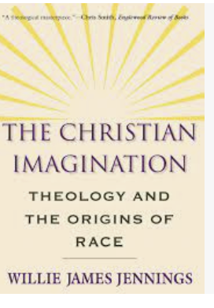
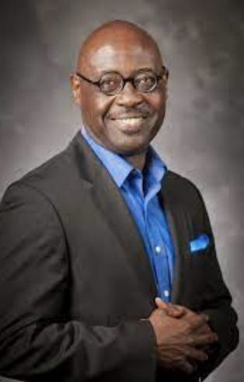

Slide 23
Declaration of the ELCA to the Jewish Community, 1992 and reaffirmed in 2021
In the spirit of that truth-telling, we who bear his name and heritage must with pain acknowledge also Luther's anti-Judaic diatribes and the violent recommendations of his later writings against the Jews. As did many of Luther's own companions in the sixteenth century, we reject this violent invective, and yet more do we express our deep and abiding sorrow over its tragic effects on subsequent generations. In concert with the Lutheran World Federation, we particularly deplore the appropriation in our day of Luther's words by modern anti-Semites for the teaching of hatred and incitement to violence toward Judaism and the Jewish people.

Slide 24
Rejecting the Doctrine of Discovery
To repudiate explicitly and clearly the European-derived doctrine of discovery as an example of the “improper mixing of the power of the church and the power of the sword” (Augsburg confession, article XXVIII, Latin text), and to acknowledge and repent from this church’s complicity in the evils of colonialism in the Americas, which continue to harm tribal governments and individual tribal members; to offer a statement of repentance and reconciliation to native nations in this country for damage done in the name of Christianity;

Slide 25
Apology to Persons of African Descent, 2019
To confess and repent of the Lutheran church’s complicity in 400 years of enslavement, oppression and marginalization of African descent people and other marginalized populations;
To acknowledge with regret that the ELCA as an institution has and continues to contribute to racial harassment and discrimination against people of African descent through corporate action, policy and practices and to request the Office of the Secretary, in consultation with appropriate churchwide organization units, to review and report on current governing documents in light of these concerns;

Slide 26
ELCA Commitment
We Shall: Commemorate June 17th as a Day Of Repentance in the ELCA for the martyrdom of The Emanuel 9; and have the names of The Emanuel 9 (Clementa C. Pinckney, Cynthia Marie Graham Hurd, Susie Jackson, Ethel Lee Lance, DePayne Middleton-Doctor, Tywanza Sanders, Daniel L. Simmons, Sharonda Coleman-Singleton, and Myra Thompson) added to future ELCA publications to venerate their martyrdom and lead us to repentance because of the white supremacy and racism in our church;

Slide 27
Confessing Racism: A Lament for the Church
As church, we confess the sin of racism and condemn racist rhetoric and the ideology of white supremacy. God, have mercy. God, have mercy.
As church, we confess, repent, and repudiate the times when this church has been silent in the face of racial injustice. God, have mercy. God, have mercy.
Racism is deeply ingrained within the ELCA, a predominantly white church. It is deeply embedded within the individual congregations whose members continue to foster stereotypes and support polices that actively hurt people of color. God, have mercy. God, have mercy.

Slide 28
Confessing Racism: A Lament for the Church
As church, we declare that the enslavement of black bodies and the removal of indigenous peoples established racism in the United States, a truth this nation and this church have yet to fully embrace. God, have mercy. God, have mercy.
Rooted in slavery, racism is manifested through the history of Jim Crow policies, racial segregation, the terror of lynching, extrajudicial killings by law enforcement, and the disproportionate incarceration of people of color. God, have mercy. God, have mercy.
As church we lament the institutional racism of discriminatory treatment within the call process; inequitable compensation of clergy of color; racial segregation; divestment from black communities and congregations; systemic policies and organizational practices; and a failure to fully include the gifts of leadership and worship styles of black people, indigenous people, and people of color. God, have mercy. God, have mercy.

Slide 29
Confessing Racism: A Lament for the Church
Confessions are empty promises without meaningful actions—actions that are grounded in prayer, education, and soul-searching repentance. The sin of racism separates us from one another. Though we trust that we are reconciled to God through Christ’s death and resurrection, we seek such life-giving reconciliation with one another. As we repent, let us not turn back to ideologies that promote white supremacy. We trust that God can make all things new. Amen.

